Slide 1

Big(0), Data Structures and
OOPS

Slide 2
Big, (O)? What is all this?
How to we measure the efficiency of an algorithm? Do we simply look at execution time and measure it in seconds?? Or computational space?
When trying to characterize an algorithm’s efficiency, it is important to quantify the number of operations or steps that the algorithm will require.
Let’s unpack all this.

Slide 3
The algorithm of Summation
If we wanted to understand the number of steps required to add 100 numbers in Python.
Lets’ count the number of assignments.
The number of assignment statements is 1 (j=0) plus the value of n (the number of times we perform j=j+i). We can denote this by a function, call it T, where T(n)=1+n.
def addition(n): j = 0 for i in range(n+1): j = j + i return j

Slide 4
Big (O), Order of Magnitude
We can then say that the sum of the first 100 integers is a bigger instance of the summation problem than the sum of the first 10 since there are more steps.
It turns out that the exact number of operations is not as important as determining the most dominant part of the T(n) function. In other words, as the problem gets larger, some portion of the T(n) function tends to overpower the rest. What is this portion for the addition algorithm??
The order of magnitude function describes the part of T(n) that increases the fastest as the value of n increases. Order of magnitude is often called Big-O notation (for “order”).

Slide 5
Consider this function
def func(n):
a=5 b=6 c=10 for i in range(n): for j in range(n): x = i * i y = j * j z = i * j for k in range(n): w = a*k + 45 v = b*b d = 3
3 constant terms
3 assignments performed n² times.
2 assignments performed n times and 1 constant term

Slide 6
Common Magnitude of Functions
f(n) | Name
1 | Constant
logn | Logarithmic
n | Linear
nlogn | Log Linear
n² | Quadratic
n³ | Cubic

Slide 7
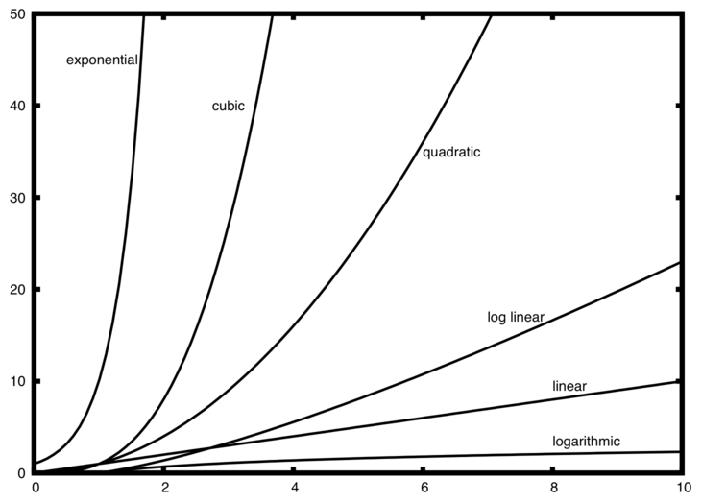
Common Magnitude of Orders

Slide 8
What are data structures?
An abstract data type, sometimes abbreviated ADT, is a logical description of how we view the data (the state) and the operations that are allowed (behaviour) without regard to how they will be implemented. The implementation of an abstract data type, often referred to as a data structure, will require that we provide a physical view of the data using some collection of programming constructs and primitive data types.
An ADT is a mathematical model for data types, where a data type is defined by its behavior (semantics) from the point of view of a user of the data, specifically in terms of possible values, possible operations on data of this type, and the behavior of these operations. This contrasts with data structures, which are concrete representations of data, and are the point of view of an implementer, not a user.

Slide 9
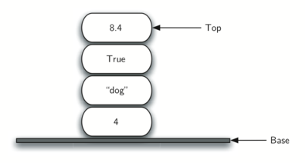
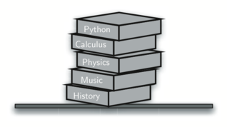
What’s a Stack?
A Stack is an ordered collection of items where the addition of new items and the removal of existing items always takes place at the same end. This end is commonly referred to as the “top.” The end opposite the top is known as the “base.”

Slide 10
Useful properties of Stack’s
One of the most useful ideas related to stacks comes from the simple observation of items as they are added and then removed. Assume you start out with a clean desktop. Now place books one at a time on top of each other. You are constructing a stack.
Consider what happens when you begin removing books. The order that they are removed is exactly the reverse of the order that they were placed. Stacks are fundamentally important, as they can be used to reverse the order of items.
Example every web browser has a Back button. As you navigate from web page to web page, those pages are placed on a stack (actually it is the URLs that are going on the stack). The current page that you are viewing is on the top and the first page you looked at is at the base.

Slide 11
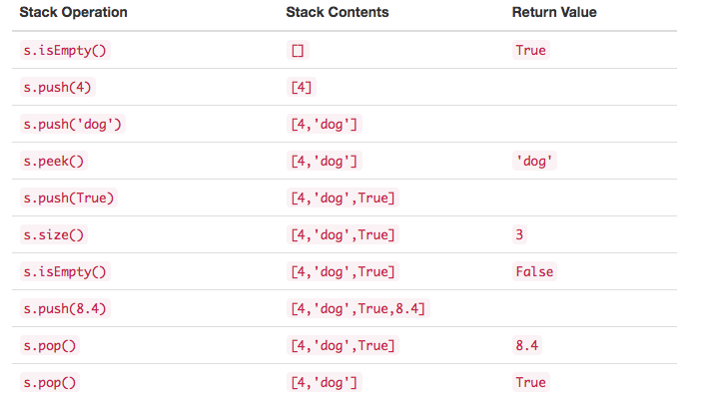
Stack Abstract Data Type
The Stack abstract data type is defined by the following structure and operations.

Slide 12
Concrete Application of Stack
Where are Stacks used you ask? Book stores?
Integer values are common data items. . The decimal number 233₁₀ and its corresponding binary equivalent 11101001₂ are interpreted respectively as 2×10²+3×10¹+3×10⁰
and
1×2⁷+1×2⁶+1×2⁵+0×2⁴+1×2³+0×2²+0×2¹+1×2⁰
But how can we easily convert integer values into binary numbers? The answer is an algorithm called “Divide by 2” that uses a stack to keep track of the digits for the binary result.

Slide 13
Stack for Decimal number → Binary
The Divide by 2 algorithm assumes that we start with an integer greater than 0. A simple iteration then continually divides the decimal number by 2 and keeps track of the remainder.
The first division by 2 gives information as to whether the value is even or odd. An even value will have a remainder of 0. It will have the digit 0 in the ones place. An odd value will have a remainder of 1 and will have the digit 1 in the ones place. We think about building our binary number as a sequence of digits; the first remainder we compute will actually be the last digit in the sequence. we again see the reversal property that signals that a stack is likely to be the appropriate data structure for solving the problem.

Slide 14
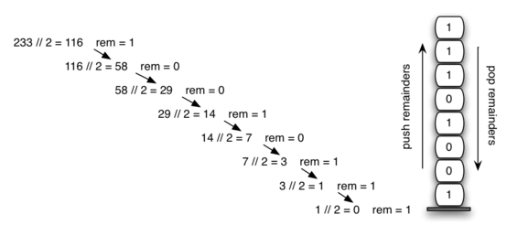
Stack for Decimal number → Binary
Notes:
The function divideBy2 takes an argument that is a decimal number and repeatedly divides it by 2. Line 7 uses the built-in modulo operator, %, to extract the remainder and line 8 then pushes it on the stack. After the division process reaches 0, a binary string is constructed in lines creates an empty string. The binary digits are popped from the stack one at a time and appended to the right-hand end of the string. The binary string is then returned.

Slide 15
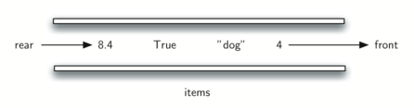
What are Queues?
A queue is an ordered collection of items where the addition of new items happens at one end, called the “rear,” and the removal of existing items occurs at the other end, commonly called the “front.” As an element enters the queue it starts at the rear and makes its way toward the front, waiting until that time when it is the next element to be removed.

Slide 16
A simple Application: Printer jobs
Your computer laboratory has 30 computers networked with a single printer. When students want to print, their print tasks “get in line” with all the other printing tasks that are waiting. The first task in is the next to be completed.

Slide 17
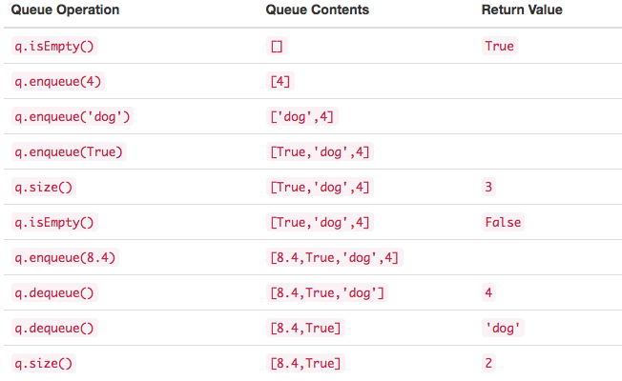
Queue Abstract Data Type
The queue abstract data type is defined by the following structure and operations

Slide 18
Let’s implement an Abstract Data Type: Fraction
So although Python has similar in-built data types for numeric classes like floating points, in this case we would like to represent the fraction as an exact value.
The operations for the Fraction type will allow a Fraction data object to behave like any other numeric value. We need to be able to add, subtract, multiply, and divide fractions (BEHAVIOUR)
We also want to be able to show fractions using the standard “slash” form, for example, ⅗ (BEHAVIOUR)

Slide 19
Object Oriented Programming
In OOP’s we have two main entities, classes and class instances. If a toy factory is a class, then the toys they produce are an instance of that class.
Although each instance has the basic underlying structure, individual attributes like color or feet can be changed, these are similar to instance Attributes.
Classes and instances are related to each other: classes provide the definition of an object, and instances are the objects specified in the class definition brought to life.

Slide 20
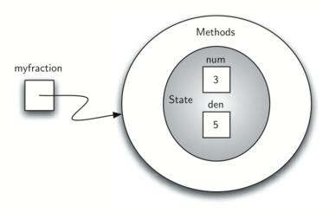
Representation of Implementation

Slide 21
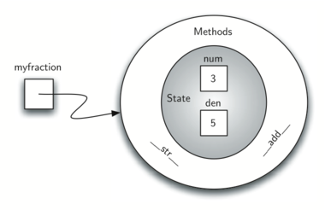
Behaviour: Representation of Implementation

Slide 22
Challenge
Implement subtraction, multiplication, division and the comparison operators (< and >)

Slide 23
Class Inheritance
Inheritance is the ability for one class to be related to another class in much the same way that people can be related to one another. Children inherit characteristics from their parents. Similarly, Python child classes can inherit characteristic data and behavior from a parent class. These classes are often referred to as subclasses and superclasses.
By organizing classes in this hierarchical fashion, object-oriented programming languages allow previously written code to be extended to meet the needs of a new situation.

Slide 24
Advantages of Object Oriented programming
Reusability - Objects created for Object Oriented Programs can easily be reused in other programs.
Encapsulation - Once an Object is created, knowledge of its implementation is not necessary for its use.
Flexibility - We can create any object and have it behave exactly how we want it to.

